Slide 1
Exploring Tradeoffs Between Power and Performance for a Scientific Visualization Algorithm
Stephanie Labasan & Matt Larsen (University of Oregon),
Hank Childs (Lawrence Berkeley National Laboratory)
26 October 2015
Notes:
Thank you for having me this morning. I’d like to also thank my co-authors, Matt Larsen and Hank Childs.

Slide 2
Overview
Motivation: Power is becoming a leading design constraint in HPC
Goal: Save energy/power
Idea: Reduce CPU clock frequency
This idea is well suited specifically for visualization
visualization is data-intensive
Proposition for users: Run X% slower, save Y% in energy/power
Study: Consider a visualization algorithm (isosurfacing) and investigate which factors most affect X and Y
Notes:
Our study was motivated by the fact that power is becoming a leading design constraint in HPC..
One idea to achieving this goal is to reduce clock freq, which is well-suited for visualization because visualization is data-intensive. This leads to the following proposition for users: if you’re willing to run X% slower, then you can save Y% in energy/power.

Slide 3
Outline
Background
Strategy & Research Questions
Experimental Overview
Results
Takeaways
Notes:
First, I’ll cover some background information.

Slide 4
Power Costs
1 MW of power cost $1M per year
Supercomputing centers are paying ~$10M
As machines get larger, cost rises, unless we innovate power-efficient techniques
Techniques may come from HW, but SW as well
Rank | System | Cores | Rmax (PFLOPS) | Power (MW)
1 | Tianhe-2, China | 3.12M | 33.9 | 17.8
2 | Titan, ORNL | 560K | 17.6 | 8.2
3 | Sequoia, LLNL | 1.57M | 17.2 | 7.9
4 | K computer, Japan | 705K | 10.5 | 12.7
Top500, Jun2015
Notes:
On the right I show the top 4 supercomputers as of this past June. In addition to their high computational performance, they also have high power consumption. The typical assumption is that 1 MW of power cost…

Slide 5
Energy vs. Power
Energy
Power
Units: Joules
Total work done
Monthly bill from electric company (e.g., 11¢/kWh) – “power bill”
Units: Joules/s, Watts
Rate of energy usage
Notes:
Before we dive any further, let’s define some key terms

Slide 6
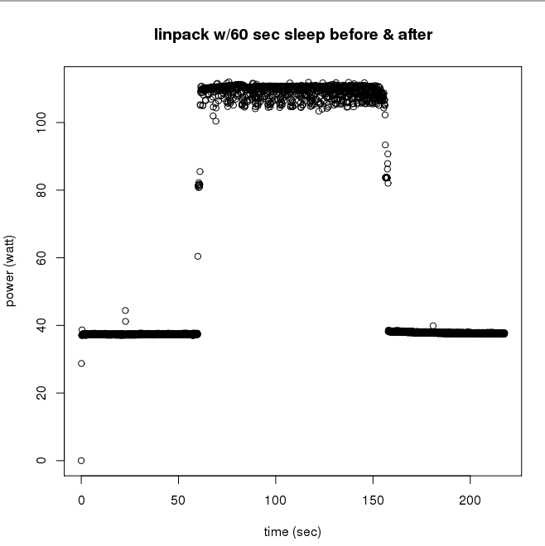
CPU Power Usage Varies Over Time
Base power usage for idle state
When more HW components are engaged (cache, vector units, etc.), power rises
Energy usage would be the area under this power curve
Computationally-intensive HPC benchmark (Linpack) running on small cluster
Notes:
The power that a processor uses will vary over the lifetime of an application.

Slide 7
Save Energy/Power?
Energy
Power
For a single application execution, minimize energy consumption ($$)
Energy-to-solution
Workstations, data centers
Reduce rate at which application consumes energy
Save power != Save $$/energy
Run at 40W, take 10s = 400J
Run at 30W, take 15s = 450J
Increase throughput (concurrent jobs)
Supercomputers
Notes:
Users running on workstations at home may want to reduce energy usage to minimize monthly bills. There are also some data centers that enforce an energy bound on a per job basis, so it's up to the application developers to ensure their algorithms are energy efficient

Slide 8
Save Energy/Power?
Energy
Power
For a single application execution, minimize energy consumption ($$)
Energy-to-solution
Workstations, data centers
Save power != Save $$/energy
Run at 40W, take 10s = 400J
Run at 30W, take 15s = 450J
Reduce rate at which application consumes energy
Increase throughput (concurrent jobs)
Supercomputers
Job1
Job3
Power
Power
Job2
Job1
Time
Time

Slide 9
Department of Energy Perspectives on Exascale Challenges
Systems | 2009 | “2018” “2020” | Difference Today & 2018 2020
System peak | 2 Pflop/s | 1 Eflop/s | O(1000)
Power | 6 MW | ~20 MW | ~3
System memory | 0.3 PB | 32-64 PB [.03 Bytes/Flop] | O(100)
Node performance | 125 GF | 1,2 or 15 TF | O(10)-O(100)
Node memory BW | 25 GB/s | 2- 4 TB/s [.002 Bytes/Flop] | O(100)
Node concurrency | 12 | O(1k) or 10k | O(100)-O(1000)
Total Node Interconnect BW | 3.5 GB/s | 200-400GB/s | O(100)
System size (nodes) | 18,700 | O(100,000) to O(1M) | O(100)-O(1000)
Total Concurrency | 225,000 | O(billion) [O(10) to O(100) for latency hiding] | O(100)
Storage | 15 PB | 500-1000 PB (>10x system memory in min) | O(10)-O(100)
IO | 0.2 TB | 60 TB/s (how long to drain the machine) | O(100)
MTTI | Days | O(1 day) | - O(10)
Systems | 2009 | “2018” “2020”
System peak | 2 Pflop/s | 1 Eflop/s
Power | 6 MW | ~20 MW
Until now, innovations in power savings have been hardware driven.
However, to reach 1 Exaflop/20 MW, software improvements may be needed.
Adapted from P Beckman
Notes:
Here I show exascale challenges defined by the Department of Energy. I want to focus our attention on two of them here.
In 2009 when this slide was made, the challenge to achieving exascale was increasing computation by 3 orders of magnitude but only increasing power consumption by 1 order of magnitude. In other words, we needed to be 100X more power-efficient. Since then, there have been several power-efficiency innovations to reduce the power-efficient factor. These have mostly been driven by hardware, such as the integration of GPU and many-core. As we near 2020 when we expect to see the first exascale machine, in order to reach our goal at the 20MW power cap set by the Dept of Energy, software improvements may also be needed to complement our hardware solutions.

Slide 10
Power on Future HPC Systems
Two scenarios:
Machine’s max power consumption <= 20 MW
i.e., even Linpack stays <= 20 MW
Machine’s max power consumption > 20 MW
Controls needed to enforce power usage at 20 MW cap
Power allocation would be coordinated by a central manager
Our study is important for scenario (2), but also has cost implications for (1).
Notes:
There are two scenarios for what power will look like on future HPC systems.

Slide 11
Outline
Background
Strategy & Research Questions
Experimental Overview
Results
Takeaways

Slide 12
Power-Saving Technique: Reduce Clock Frequency
Outcome: Takes longer to run, but uses less power
Why: Non-linear relationship between frequency and power
Reduced clock frequency results in less power consumption
but, subcomponents still consume power at the same rate
Will lead to power savings
May lead to energy savings, may not

Slide 13
Data-Intensive Applications
Architecture with separate clock frequencies for cache and compute unit (e.g., Intel Haswell)
Enables reduction of clock frequency without impacting cache
Ideal outcome:
Reduce clock frequency
Achieve energy/power savings
Runtime does not change
Some visualization algorithms are data-intensive
Notes:
Split into multiple slides, emphasize visualization and separate clock freq

Slide 14
Benchmark Tests
computeBound: Several multiplication ops on a single variable
computeBoundILP: computeBound with instruction-level parallelism for pipelining
memoryBound: Accesses an element in one array and writes it to another based on an index
memoryBoundCacheThrash: memoryBound with randomized output locations, removing any benefit of locality
Vis algorithms??
Vis algorithms??
Notes:
Explain graph

Slide 15
Research Questions
Data-intensity: If you reduce the clock frequency by X, does the runtime increase by X? or less?
Energy proposition: If you are willing to run X% slower, you can save Y% in energy
Power proposition: If you are willing to run X% slower, you can save Z% in power

Slide 16
Outline
Background
Strategy & Research Questions
Experimental Overview
Results
Takeaways

Slide 17
Factors Studied
Hardware architecture
2 options
CPU1 | CPU2
Workstation: Intel i7 4770K (Haswell) | Supercomputer: NERSC’s Edison (Ivy Bridge)
4 HT cores @ 3.5 GHz | 12 HT cores @ 2.4 GHz
32 GB memory @ 1600 MHz | 64 GB memory @ 1866 MHz

Slide 18
Factors Studied
Hardware architecture
CPU clock frequency
CPU1 | CPU2
Workstation: Intel i7 4770K (Haswell) | Supercomputer: NERSC’s Edison (Ivy Bridge)
4 HT cores @ 3.5 GHz | 12 HT cores @ 2.4 GHz
32 GB memory @ 1600 MHz | 64 GB memory @ 1866 MHz
11 frequency steps | 7 frequency steps
Linux cpufreq-utils tool | ALPS aprun job launcher
Notes:
ALPS: application level placement scheduler

Slide 19
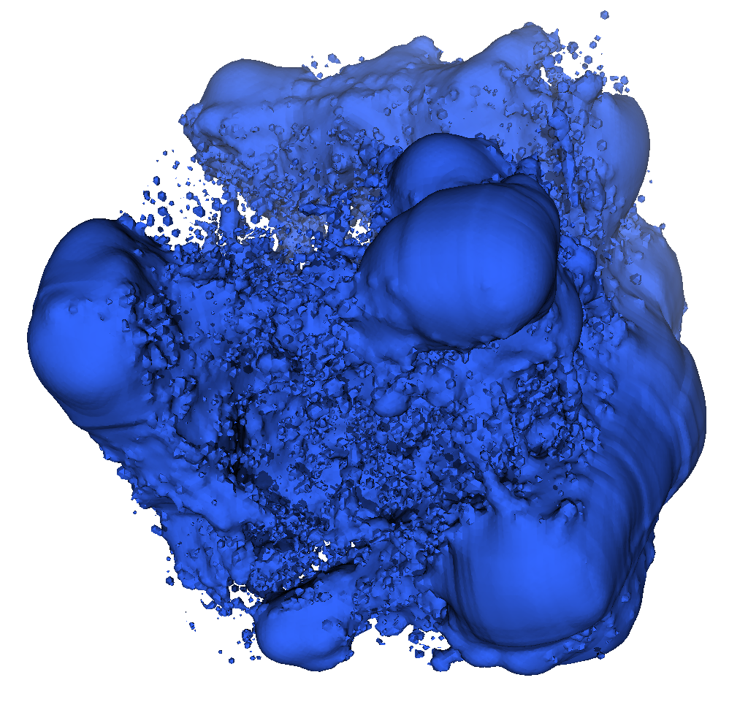

Factors Studied
Hardware architecture
CPU clock frequency
Data set
8 options
Enzo | Nek5000
Cosmology simulation, structured, rectilinear grid to tetrahedrons | Thermal hydraulics simulation, unstructured, hexahedrons to tetrahedrons
Three data sets of varying sizes: Enzo-1M, Enzo-10M, Enzo-80M | Nek5000
Same as above, but increase data-intensity: REnzo-1M, REnzo-10M, REnzo-80M | RNek5000
Isoval: 170 | Isoval: 0.3
Enzo
Nek5000
Notes:
Data sets originated from 2 simulations: Enzo and Nek5000. Our data set generation led to regular cache layouts, we wanted to see what would happen if we had irregular layouts, which is why we increased the data intensity by randomizing the point indices. For the Enzo and Nek5000 data set, we selected 1 isovalue for each.

Slide 20
Factors Studied
Hardware architecture
CPU clock frequency
Data set
Parallel programming model
2 options
Concurrency
4 options
OpenMP: Cores operate on a common data set, enabling opportunity for cache coordination
MPI: Each core operates on a local copy of the data set, leading to uncoordinated cache accesses

Slide 21
Factors Studied
Hardware architecture
CPU clock frequency
Data set
Parallel programming model
Concurrency
Isosurface implementation
2 options
Baseline: Our own implementation that only performs isosurfacing on tetrahedrons using linear interpolation.
General: Implemented using VTK, specifically vtkContourFilter. Algorithm performs isosurfacing in a general way (many cell types, higher order elements, etc.).
Notes:
Supports different data models, different algorithms

Slide 22
Methodology
Factors Studied
Hardware architecture
CPU clock frequency
Data set
Parallel programming model
Concurrency
Isosurface implementation
Study conducted in 6 phases
Phase 1: Vary clock frequency on Baseline Implementation, 1 data set, OpenMP, max concurrency on workstation
Each phase varies 1 factor to investigate effects
Notes:
Sub-sequent

Slide 23
Outline
Background
Strategy & Research Questions
Experimental Overview
Results
Takeaways

Slide 24
General Notations & Relationships
Clock frequency:
F_{D} = nominal frequency
F_{R} = reduced frequency
For a given application,
Runtime:
T_{D} = time taken at frequency F_{D}
T_{R} = time taken at frequency F_{R}
Energy:
E_{D} = energy used at frequency F_{D}
E_{R} = energy used at frequency F_{R}
Power:
P_{D} = power used at frequency F_{D}
P_{R} = power used at frequency F_{R}
F_{rat} = F_{D}/F_{R}
T_{rat} = T_{R}/T_{D}
E_{rat} = E_{D}/E_{R}
P_{rat} = P_{D}/P_{R}
If T_{rat} < F_{rat}, then data-intensive application (e.g., does not slowdown proportional to clock frequency)
Energy savings: T_{rat} vs. E_{rat}
Power savings: T_{rat} vs. P_{rat}
No need to be overwhelmed – we’ll go over these in the next slides.
Notes:
Defined some terms, showing them to you now, will go through these in later slides

Slide 25
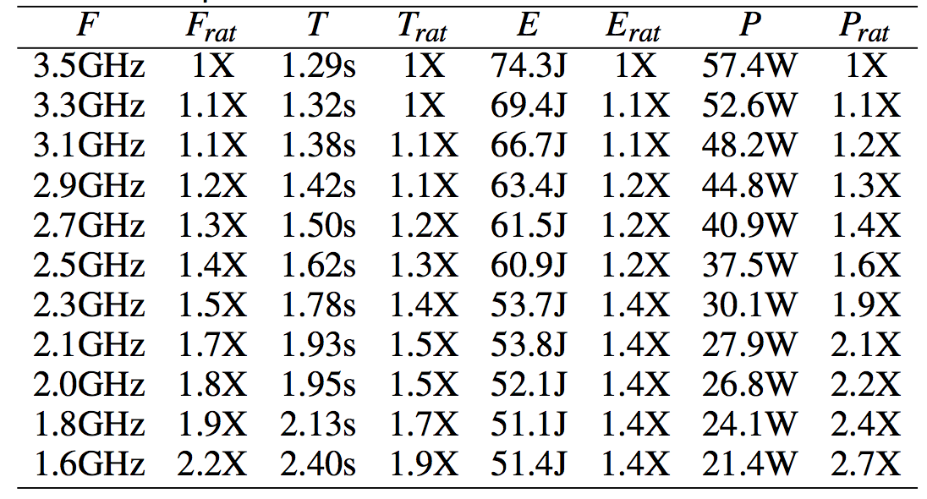
Phase 1 Results: Vary CPU Frequency
Reducing clock frequency by 2.2X:
Runtime: increases by 1.9X
Energy: decreases by 1.4X
Power: decreases by 2.7X
Implementation tends towards compute-intensive, but not as strongly as our compute-bound benchmark
Favorable energy/power savings
Baseline Implementation, Enzo-10M, CPU1, OpenMP

Slide 26
Changes in Phase 2
Changes: Execute our own isosurfacing algorithm on all 8 data sets
Goal: Investigate how data-intensity and size affects our propositions

Slide 27
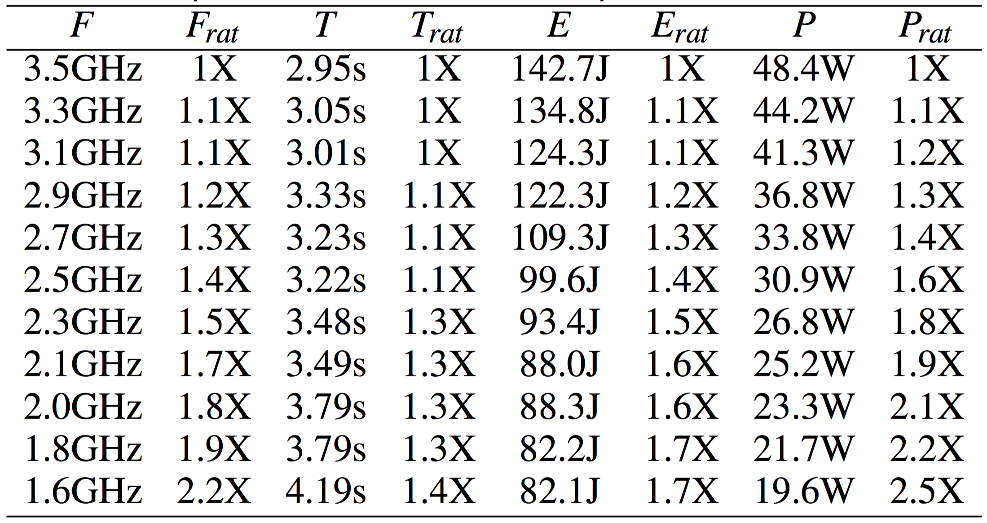
Phase 2 Results: Vary Data Set
Increase data-intensity of data set:
Runtime: increases by 1.4X (versus 1.9X in last slide)
→ More data-intensive than before
Energy: decreases by 1.7X (versus 1.4X in last slide)
Power: decreases by 2.5X (versus 2.7X in last slide) due to increased cache misses
Baseline Implementation, REnzo-10M, CPU1, OpenMP
Notes:
NOTE: What’s specifically changed here is that we’re now using the randomized version of the previous data set, which we call Renzo-10M.
Don’t save as much power as in the previous slide because of the increased cache misses due to the irregular cache layout of our data set.
Increasing intensity of 1 data set from previous slide

Slide 28
Phase 2 Results: Vary Data Set
Smallest data set suffers largest impact to runtime with minimal energy savings
Energy savings: Improves for data sets with increased data-intensity
Cache misses differ across data sets
Smallest data set has largest slowdown and minimal energy savings.
All propositions improve as we increase data-intensity.
Baseline Implementation, CPU1, OpenMP
Notes:
Continuing Phase 2, we ran the same test from the previous slide on the remaining datasets and these are our results.
Here we’re only looking at the ratio between default (3.5GHz) and lowest frequencies (1.6GHz)

Slide 29
Changes in Phase 3
Changes: Use MPI instead of OpenMP to implement our own isosurfacing algorithm and perform isosurfacing on all 8 data sets
Goal: Investigate the effects of non-coordinated cache accesses on our algorithm

Slide 30
Phase 3: Vary Programming Model
Non-randomized data sets
Two clusters: Increase data-intensity of data set causes less impact to runtime
Energy savings: Larger energy savings than OpenMP (1.7X vs. 2X)
Randomized data sets
Baseline Implementation, CPU1, MPI
Notes:
With MPI, our clusters become more distinct. We have our non-randomized data sets slowing down proportional to the clk freq. Our randomized data sets have a smaller slowdown. We find that the differences between our two programming models greatly affects the slowdown of our data sets because of the method in which it uses memory.
Explain difference in memory usage between mpi and openmp (distinct clusters)

Slide 31
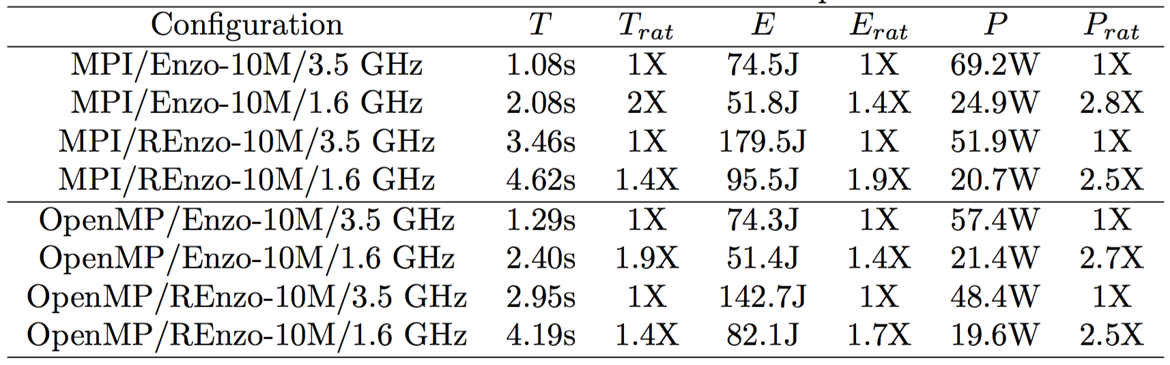
Phase 3: Vary Programming Model
Energy savings: Better with MPI than with OpenMP, MPI uses more energy
→ MPI process is heavier weight than OpenMP thread
Power savings: MPI uses more power than OpenMP, especially on randomized data set
→ MPI makes less efficient use of memory than OpenMP

Slide 32
Changes in Phase 4
Changes: Increase the level of concurrency when executing the OpenMP and MPI implementations of our own isosurfacing algorithm
Goal: Investigate the effects of increased memory requests between the two programming models

Slide 33
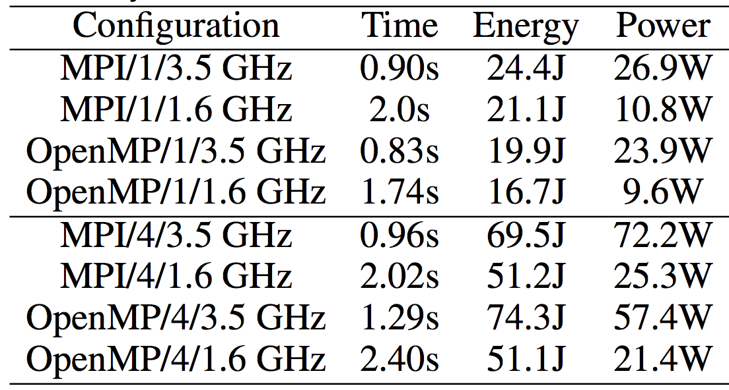
Phase 4: Vary Concurrency
Power savings @1 core: MPI and OpenMP save 2.5X
Power savings @4 cores: MPI saves 2.8X and OpenMP saves 2.68X
Increasing concurrency causes more memory requests, leading to memory BW saturation (less instructions executed)*
*performance metrics in paper
Baseline Implementation, Enzo-10M, CPU1, OpenMP/MPI

Slide 34
Changes in Phase 5
Changes: Implement the isosurfacing algorithm using VTK’s contour filter
Goal: Investigate the effects of using a different implementation, specifically an implementation using general-purpose visualization library that is designed for diverse usage (e.g., cell types, higher order elements, etc.)

Slide 35
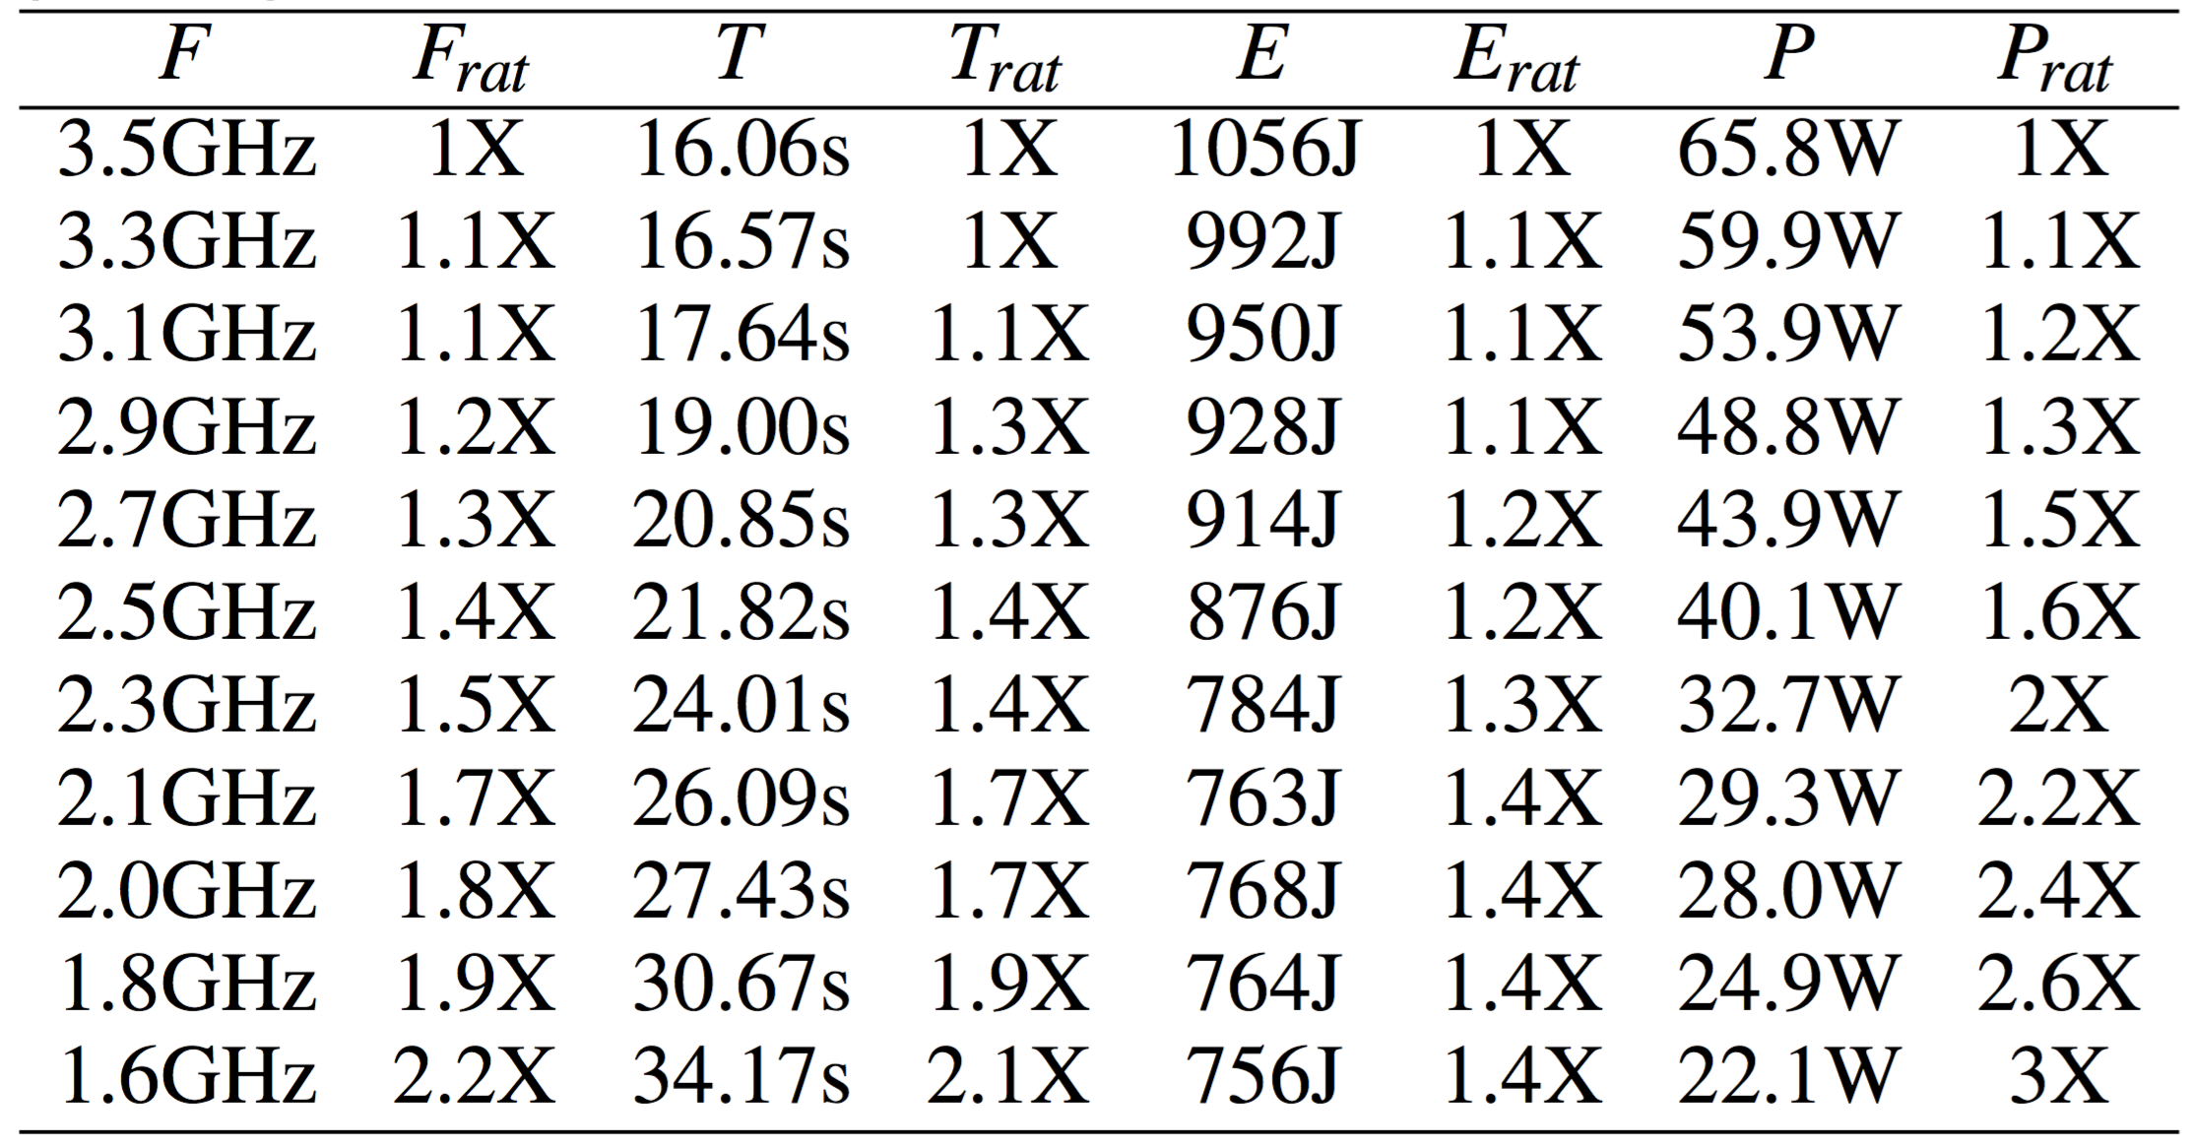
Phase 5: Vary Algorithm Implementation
Compute-intensive: F_{rat} and T_{rat} are highly correlated
Number of instructions issued differs between implementations (102 billion vs. 7 billion)
Algorithm shifts from data- to compute-intensive and propositions become less favorable
General Implementation, Enzo-10M, CPU1, OpenMP

Slide 36
Changes in Phase 6
Changes: Execute our own implementation with MPI on a different processor architecture
Shared clock frequency between cache and compute unit
In previous phases, clock frequency was decoupled
Goal: Investigate the effects of alternate hardware architectures
Notes:
Decoupled clock frequency in previous architecture/tests

Slide 37
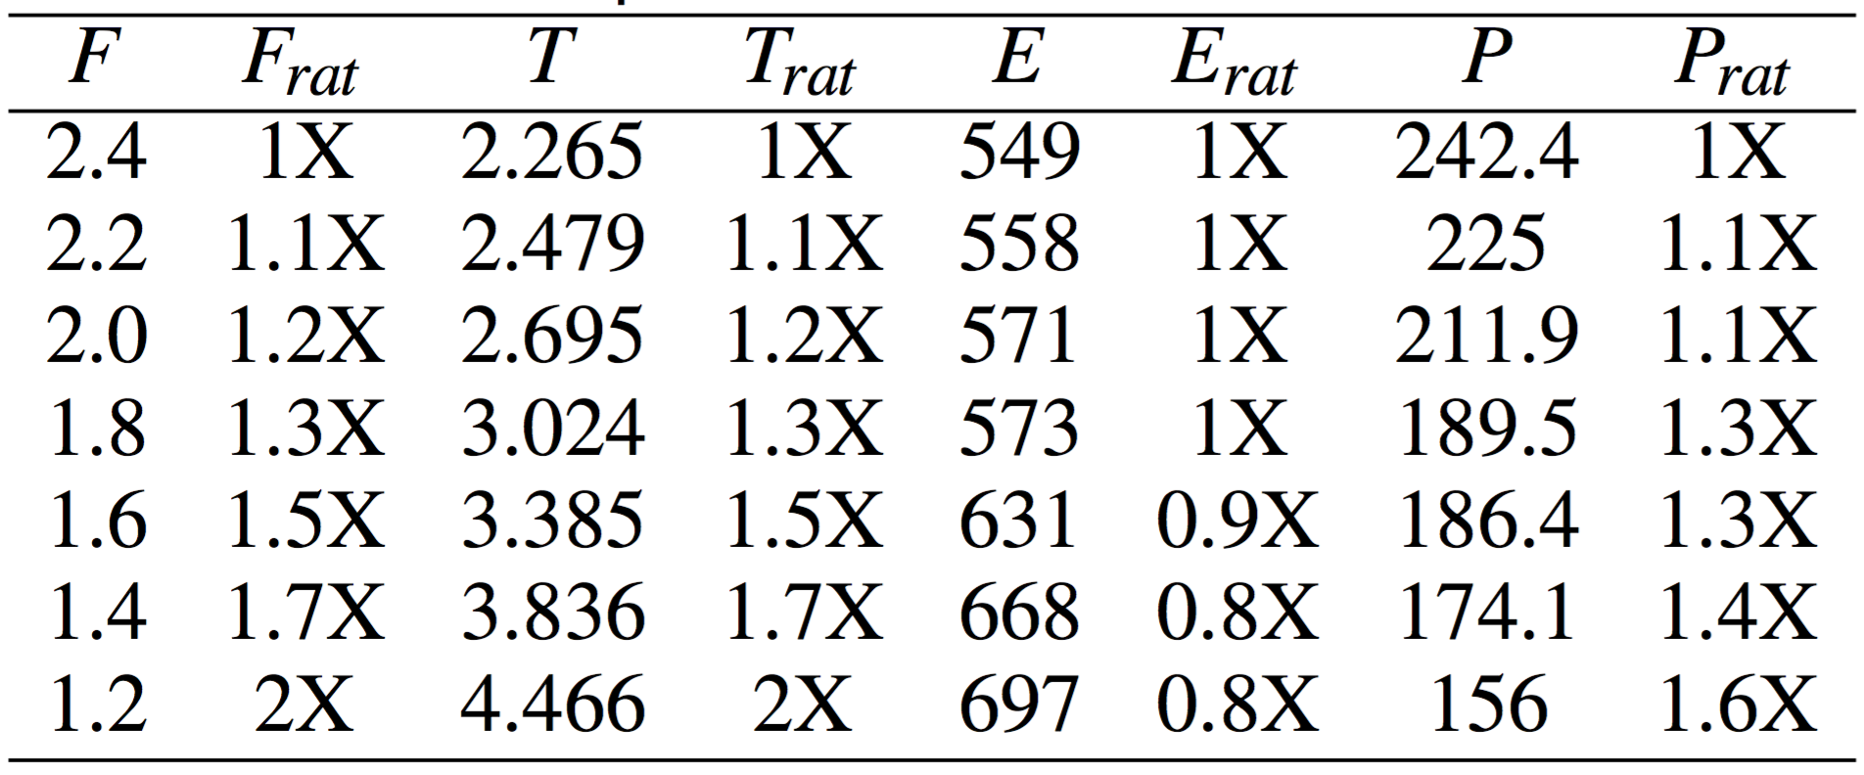
Phase 6: Vary Hardware Architecture
Single clock frequency affects compute units AND shared L3 cache rates on Intel Ivy Bridge
Propositions now unfavorable
Baseline Implementation, Enzo-10M, CPU2, MPI
Notes:
Cache and memory tied together

Slide 38
Outline
Background
Strategy & Research Questions
Experimental Overview
Results
Takeaways

Slide 39
Study Takeaways
Isosurfacing is sufficiently data-intensive to gain energy/power savings by reducing the clock frequency
Tradeoffs between runtime and energy/power become more favorable when:
Increasing data set complexity (e.g., size, irregular access patterns)
Heavily stressing memory subsystem (e.g., concurrency)
General-purpose visualization software shifts instruction counts, resulting in less favorable tradeoffs between runtime and energy/power savings
Next steps: applying factors to more visualization algorithms (i.e., particle advection, volume rendering)
Notes:
Particle advection performs data-dependent memory accesses, volume rendering requires lots of computation and irregular memory accesses

Slide 40
Acknowledgements
Department of Energy Advanced Scientific Computing Research (ASCR), Program Manager Lucy Nowell
Laura Carrington and Ananta Tiwari of San Diego Supercomputing Center for providing advice and expertise
LBNL NERSC for providing compute resources to conduct our tests
Notes:
Thank you to the Dept of Energy for funding this work, to the San Diego Supercomputing Center for their great advice, and to NERSC at Lawrence Berkeley for providing compute resources.

Slide 41

Thanks! Questions?
Stephanie Labasan
slabasan@cs.uoregon.edu
http://cdux.cs.uoregon.edu
Notes:
Thank you for attending my talk and if there’s time I’ll take questions.

